Slide 1
Section 2.9: Power Indices
Math for Liberal Studies

Slide 2
What is a Power Index?
We want to measure the influence each voter has
As we have seen, the number of votes you have doesn’t always reflect how much influence you have
First we’ll discuss the “Shapley-Shubik power index” to measure each voter’s power

Slide 3
Pivotal Voters
In order to measure the power of each voter, we will determine the number of times each voter is pivotal
For example, consider the system [8: 5, 4, 3, 2]
A has 5 votes
B has 4 votes
C has 3 votes
D has 2 votes

Slide 4
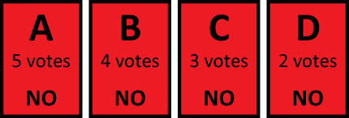
Pivotal Voters
Start off with each voter voting “no”
Then we go down the line, switching each vote from “no” to “yes” until the motion passes

Slide 5
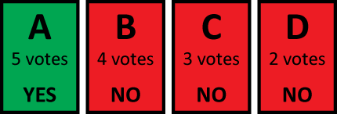
Pivotal Voters
First we switch A’s vote
But there are still only 5 votes in favor, so the motion still fails

Slide 6
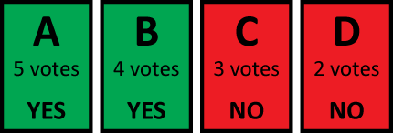
Pivotal Voters
Now we switch A’s vote
The quota is 8, so the motion passes
We say that B is the pivotal voter

Slide 7
Permutations
If we had arranged the voters differently, then the pivotal voter would have been different
For the Shapley-Shubik power index, we need to consider all of the different ways the voters can be arranged
All of these arrangements are called permutations

Slide 8
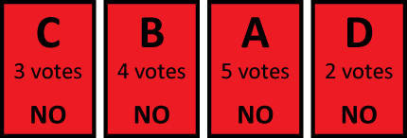
Another Permutation
Let’s examine another permutation
Again, start with all votes being “no” and switch them one at a time until the motion passes

Slide 9
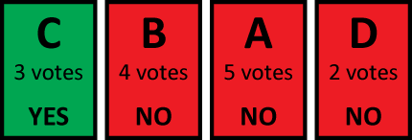
Another Permutation
Switch C’s vote
The motion still fails, so keep going

Slide 10
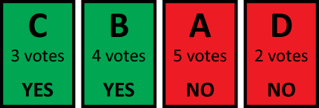
Another Permutation
Switch B’s vote
The motion still fails, so keep going

Slide 11
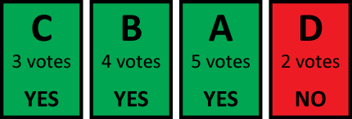
Another Permutation
Switch A’s vote
The motion passes, so A is the pivotal voter

Slide 12
Computing the Power Index
We consider every possible permutation and find the pivotal voter for each one
The Shapley-Shubik power index is the fraction of times each voter was pivotal
Each power index is a fraction: the numerator is the number of times the voter was pivotal, and the denominator is the total number of permutations

Slide 13
Lots of Permutations
For 3 voters, there are 3 × 2 × 1 = 6 permutations
For 4 voters, there are 4 × 3 × 2 × 1 = 24 permutations
For 5 voters, there are 5 × 4 × 3 × 2 × 1 = 120 permutations
For 51 voters (the US Electoral College, for example), there are 51 × 50 × 49 × … × 3 × 2 × 1 permutations. This number is 67 digits long!

Slide 14
Back to Our Example
Our example was [8: 5, 4, 3, 2]
There are 24 permutations:
ABCD | BACD | CABD | DABC
ABDC | BADC | CADB | DACB
ACBD | BCAD | CBAD | DBAC
ACDB | BCDA | CBDA | DBCA
ADBC | BDAC | CDAB | DCAB
ADCB | BDCA | CDBA | DCBA

Slide 15
Back to Our Example
Our example was [8: 5, 4, 3, 2]
For each permutation, determine the pivotal voter just like the earlier examples:
ABCD | BACD | CABD | DABC
ABDC | BADC | CADB | DACB
ACBD | BCAD | CBAD | DBAC
ACDB | BCDA | CBDA | DBCA
ADBC | BDAC | CDAB | DCAB
ADCB | BDCA | CDBA | DCBA

Slide 16
Computing the Shapley-Shubik Power Index
We see that
A was pivotal 10 times
B was pivotal 6 times
C was pivotal 6 times
D was pivotal 2 times
So the Shapley-Shubik power indices are:
Power of A = 10/24
Power of B = 6/24
Power of C = 6/24
Power of D = 2/24

Slide 17
Another Example
[10: 6, 4, 3]
ABC | BAC | CAB
ACB | BCA | CBA

Slide 18
Another Example
[10: 6, 4, 3]
ABC | BAC | CAB
ACB | BCA | CBA

Slide 19
Another Example
[10: 6, 4, 3]
Power of A = 3/6
Power of B = 3/6
Power of C = 0/6
C is a dummy voter
ABC | BAC | CAB
ACB | BCA | CBA

Slide 20
Another Power Index
When we considered the Shapley-Shubik power index, we examined all possible permutations of voters
Now we will look at all possible coalitions of voters

Slide 21
Coalitions
A coalition is a set of voters who are prepared to vote together for or against a motion
A winning coalition has enough votes to pass a motion
A blocking coalition has collective veto power: enough votes to defeat a motion

Slide 22
Examples
Consider the system [10: 8, 5, 3, 1] with the voters named A, B, C, and D
{A, B} is a winning coalition since they have 13 votes; this is also a blocking coalition
{B, C, D} is not a winning coalition since they only have 9 votes; however, this is a blocking coalition

Slide 23
Evaluating Coalitions
If the total number of votes is T and the quota is Q…
A coalition with at least Q votes is a winning coalition
A coalition with at least T – Q + 1 votes is a blocking coalition

Slide 24
Counting Coalitions
With 3 voters, there are 2 × 2 × 2 = 8 coalitions
With 4 voters, there are 2 × 2 × 2 × 2 = 16 coalitions
With 5 voters, there are 2 × 2 × 2 × 2 × 2 = 32 coalitions
With 51 voters (like the US Electoral College), there are 2 × 2 × 2 × … × 2 = 2⁵¹ coalitions. This is a 16 digit number!

Slide 25
Critical Voters
In a winning coalition, a voter is critical to the coalition if removing the voter makes the coalition no longer winning
In a blocking coalition, a voter is critical to the coalition if removing the voter makes the coalition no longer blocking

Slide 26
Back to Our Example
Our example was [10: 8, 5, 3, 1]
{A, B} is a winning coalition, and removing either A or B makes the coalition no longer winning, so A and B are both critical
{A, B} is also a blocking coalition, but if we remove B, the coalition is still blocking (A has veto power by itself). So only A is critical to this coalition

Slide 27
More Coalitions
[10: 8, 5, 3, 1]
{B, C, D} is a blocking coalition, and B and C are the critical voters
{A, B, C, D} is a winning coalition, but only A is critical
{A, B, C, D} is a blocking coalition, and none of the voters are critical (we can remove any single voter and the coalition is still blocking)

Slide 28
The Banzhaf Power Index
The Banzhaf power index is the fraction of times each voter is critical in either a winning or blocking coalition
Just like the Shapley-Shubik index, this index will measure the portion of the total power each voter has

Slide 29
Computing the Banzhaf Index
Step 1: List All Coalitions
We will list all of the possible coalitions and determine which coalitions are winning and/or blocking
Step 2: Find the Critical Voters
In each coalition, we will determine which voters are critical
Step 3: Add It Up
We will add up the number of times each voter is critical and use this to compute the power index

Slide 30
Step 1: List All Coalitions
Our example is [10: 8, 5, 3, 1]
There are 4 voters, so there are 16 coalitions
Start with the smallest coalitions and work up to the biggest ones
Next, determine which coalitions are winning and which are blocking
{ } | 0 votes
{ A } | 8 votes
{ B } | 5 votes
{ C } | 3 votes
{ D } | 1 vote
{ A, B } | 13 votes
{ A, C } | 11 votes
{ A, D } | 9 votes
{ B, C } | 8 votes
{ B, D } | 6 votes
{ C, D } | 4 votes
{ A, B, C } | 16 votes
{ A, B, D } | 14 votes
{ A, C, D } | 12 votes
{ B, C, D } | 9 votes
{ A, B, C, D } | 17 votes

Slide 31
Step 1: List All Coalitions
For the example [10: 8, 5, 3, 1], a coalition needs 10 votes to win and 17 − 10 + 1 = 8 votes to block
Winning Coalitions
{ A, B }
{ A, C }
{ A, B, C }
{ A, B, D }
{ A, C, D }
{ A, B, C, D }
Blocking Coalitions
{ A }
{ A, B }
{ A, C }
{ A, D }
{ B, C }
{ A, B, C }
{ A, B, D }
{ A, C, D }
{ B, C, D }
{ A, B, C, D }

Slide 32
Step 2: Find the Critical Voters
Now in each coalition, determine the critical voters (if any)
Winning Coalitions
{ A, B } | A, B
{ A, C } | A, C
{ A, B, C } | A
{ A, B, D } | A, B
{ A, C, D } | A, C
{ A, B, C, D } | A
Blocking Coalitions
{ A } | A
{ A, B } | A
{ A, C } | A
{ A, D } | A
{ B, C } | B, C
{ A, B, C } | none
{ A, B, D } | A
{ A, C, D } | A
{ B, C, D } | B, C
{ A, B, C, D } | none

Slide 33
Step 3: Add It Up
Next, just count how many times each voter was critical (in either way)
Winning Coalitions
{ A, B } | A, B
{ A, C } | A, C
{ A, B, C } | A
{ A, B, D } | A, B
{ A, C, D } | A, C
{ A, B, C, D } | A
Blocking Coalitions
{ A } | A
{ A, B } | A
{ A, C } | A
{ A, D } | A
{ B, C } | B, C
{ A, B, C } | none
{ A, B, D } | A
{ A, C, D } | A
{ B, C, D } | B, C
{ A, B, C, D } | none

Slide 34
Step 3: Add It Up
We see that A was a critical voter 12 times, B was critical 4 times, and C was critical 4 times
Add these all up and we get 12 + 4 + 4 = 20
The power of each voter is the number of times the voter is critical divided by this total

Slide 35
Step 3: Add It Up
We see that A was a critical voter 12 times, B was critical 4 times, and C was critical 4 times
Power of A = 12/20
Power of B = 4/20
Power of C = 4/20
Power of D = 0/20
D is a dummy voter

Slide 36
Another Example
[15: 12, 8, 4]
15 votes needed to win
24 – 15 + 1 = 10 votes needed to block
Coalition | # of Votes | Blocking? | Critical Voters | Winning? | Critical Voters
{ } | 0 votes | no | --- | no | ---
{ A } | 12 votes | yes | A | no | ---
{ B } | 8 votes | no | --- | no | ---
{ C } | 4 votes | no | --- | no | ---
{ A, B } | 20 votes | yes | A | yes | A, B
{ A, C } | 16 votes | yes | A | yes | A, C
{ B, C } | 12 votes | yes | B, C | no | ---
{ A, B, C } | 24 votes | yes | none | yes | A

Slide 37
Results
Our results for [15: 12, 8, 4] are
Power of A = 6/10
Power of B = 2/10
Power of C = 2/10
Even though B has twice as many points as C, they have the same power!

